Slide 1
Perspectives on Japanese Internment- WWII

Slide 2
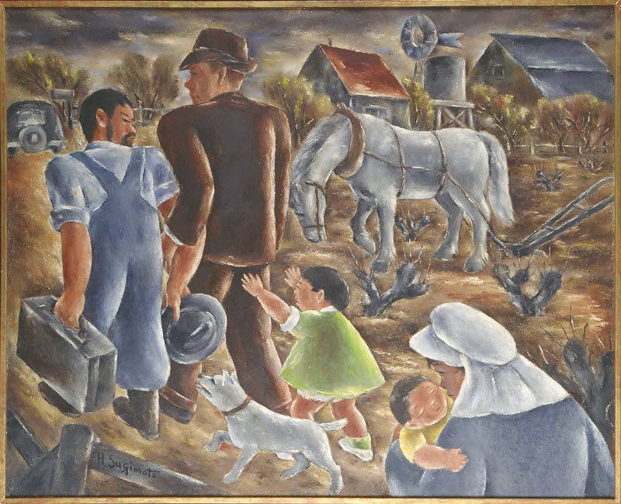
Notes:
Within a matter of 48hrs after the Japanese attack on Pearl Harbor, over 1,200 Japanese-Americans were arrested by the FBI because they were considered dangerous or disloyal to the United States. There were also 620 Germans and 98 Italians arrested – but the numbers are skewed toward those of Japanese ancestry. The sudden attack on Pearl Harbor caused widespread fear and paranoia among Americans and politicians. FDR’s military advisers recommended the exclusion of persons of foreign descent, including American citizens, from sensitive areas of the country as a safeguard against espionage and sabotage.

Slide 3
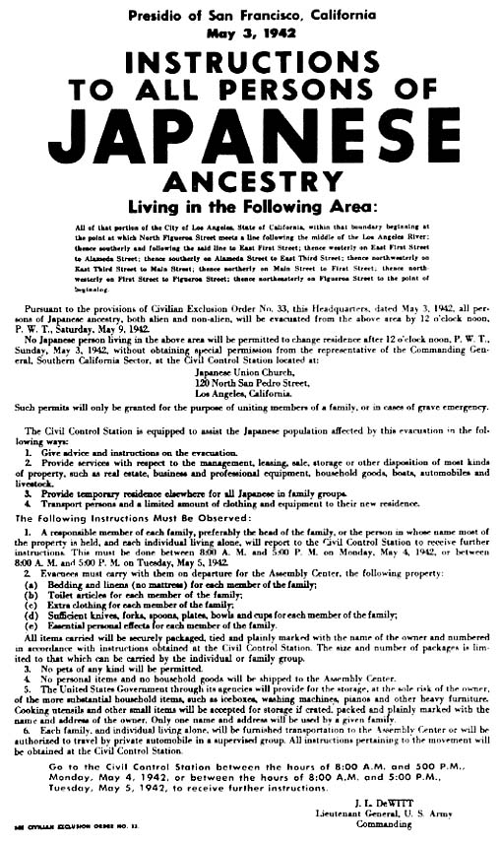
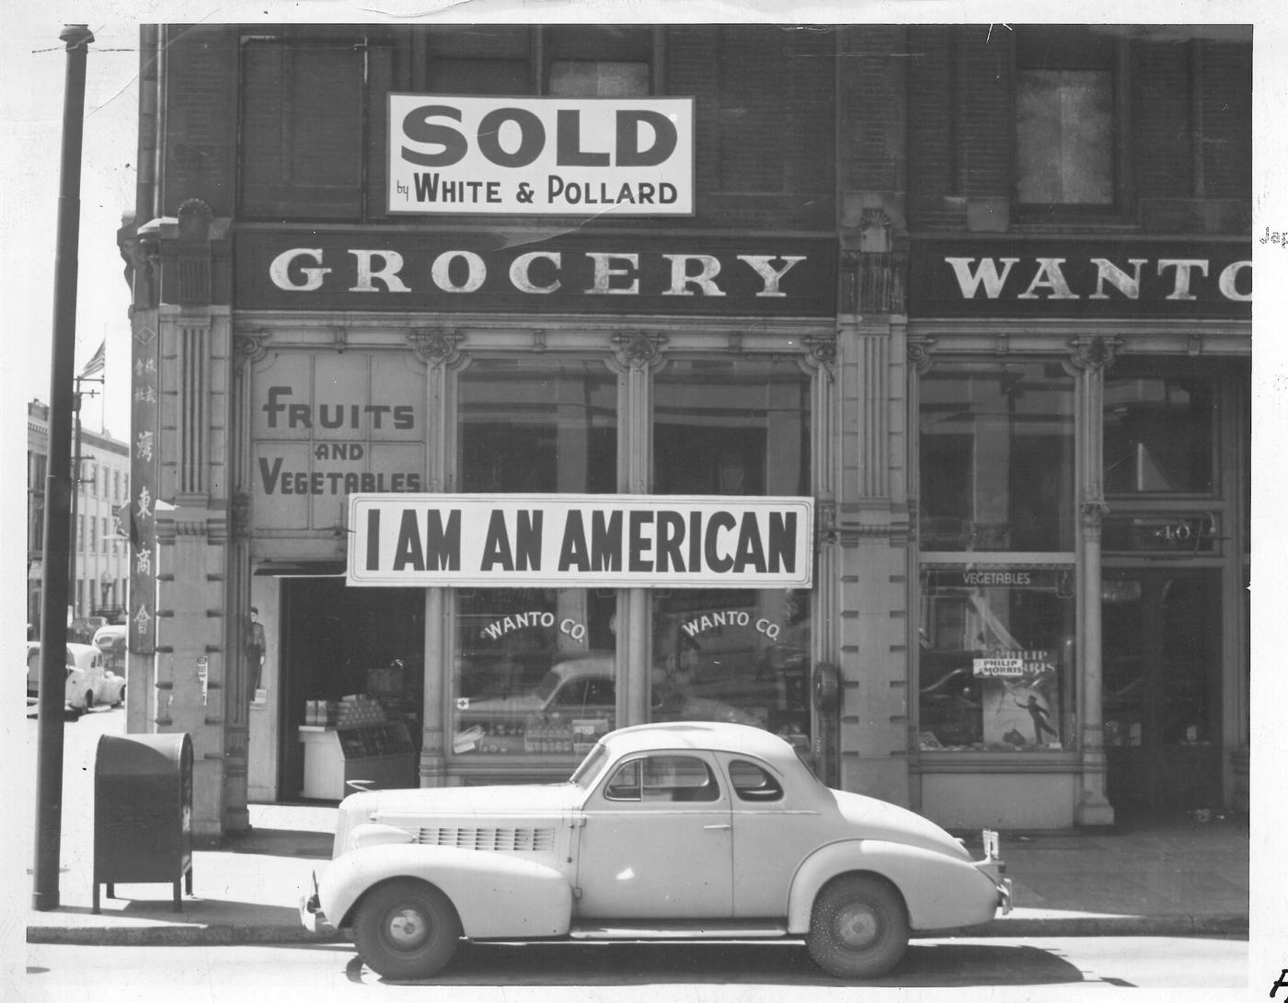
Notes:
The Justice Department initially resisted any relocation order, questioning both its military necessity and its constitutionality. But the shock of Pearl Harbor and of Japanese atrocities in the Philippines fueled already tense race relations on America’s West Coast. In the face of political, military, and public pressure, Roosevelt accepted the relocation proposal. The Attorney General acquiesced after the War Department relieved the Justice Department of any responsibility for implementation. On February 19, 1942, President Roosevelt signed Executive Order 9066 granting the War Department broad powers to create military exclusion areas. Although the order did not identify any particular group, in practice it was used almost exclusively to intern Americans of Japanese descent. By 1943, more than 110,000 Japanese Americans had been forced from their homes and moved to camps in remote inland areas of the United States.

Slide 4
Japanese Americans were forced to register and fill out a “loyalty questionnaire.” Some refused to register or sign this questionnaire. Their refusal sometimes led to jail time, or affected which Internment Camp they were sent to.

Slide 5
Instructions
We are going to examine two perspectives of Japanese Internment (The US Government and Japanese-Americans)
Your job is to take notes on each source using a “T” chart.
Write down the most important clues that tell you about what each side thought/felt about Internment.
At the end you will use your notes to create an argument Japanese Internment. Your argument should be at least one complete paragraph – so take plenty of notes!

Slide 6
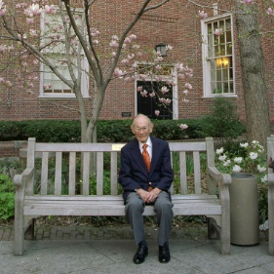
Fred Korumatsu –
Read the oral history transcript from Fred Korumatsu and take notes on your T-Chart.
Notes:
In 1983, Prof. Peter Irons, a legal historian, together with researcher Aiko Herzig-Yoshinaga, discovered key documents that government intelligence agencies had hidden from the Supreme Court in 1944. The documents consistently showed that Japanese Americans had committed no acts of treason to justify mass incarceration. With this new evidence, a pro-bono legal team that included the Asian Law Caucus re-opened Korematsu’s 40-year-old case on the basis of government misconduct. On November 10, 1983, Korematsu’s conviction was overturned in a federal court in San Francisco. It was a pivotal moment in civil rights history.

Slide 7
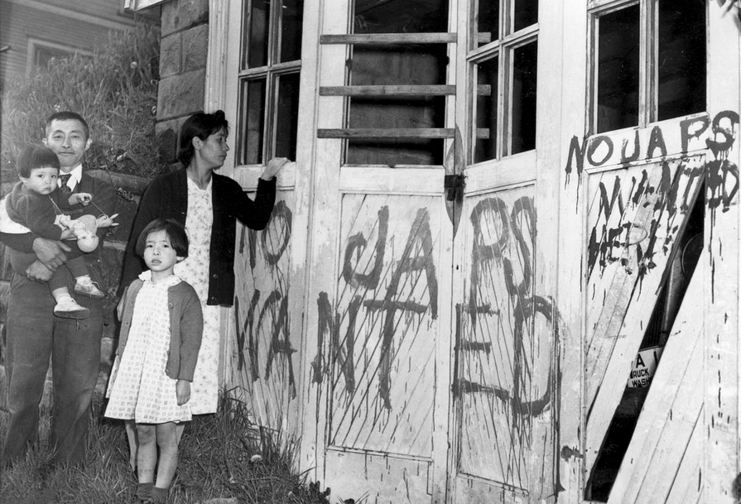
Life After “Camp”
Japanese-Americans were forced to quickly sell their businesses and property prior to being relocated to Internment Camps. Many of them lost their property, or returned home to find what they had left was vandalized.
Estimated losses (income and property) for Japanese-Americans is well into the billions of dollars.
Notes:
During internment, various anti-Japanese groups formed up and down the West Coast. In Seattle , the two most prominent anti-Japanese groups were the Remember the Pearl Harbor League (RPHL) and the Japanese Exclusion League (JEL). Though they formed during the war, their most active periods, at least according to newspaper accounts in the Seattle Times, Seattle Post Intelligencer, and the Seattle Star, were during the debate over resettlement at the end of 1944 and in early 1945.
There were many individuals and anti-Japanese organizations at the time, but there were just as many individuals and pro-Japanese organizations fighting for the rights of the Japanese and Japanese-Americans. Some of these groups included the Seattle Council of Churches, American Friends Service Committee and the Seattle Civic Unity Committee.
In the first months of 1945 as the Japanese and Japanese-Americans began to return, the controversy faded from the pages of the press. Many efforts had been taken and most citizens had decided to accept the Japanese and Japanese-Americans back into the community. The government had begun a publicity campaign on the heroism of Japanese-American Soldiers, which helped to ease a lot of the anti-Japanese fears.[42] Anti-Japanese organizations failed to prevent the military from allowing resettlement, and failed to broadly influence public opinion.
Even though the pro-Japanese organizations won and resettlement was allowed, this didn’t address the fact that many Japanese Americans had lost their property, businesses, and were left in financial disarray. Many came home to find their homes vandalized and trashed.

Slide 8
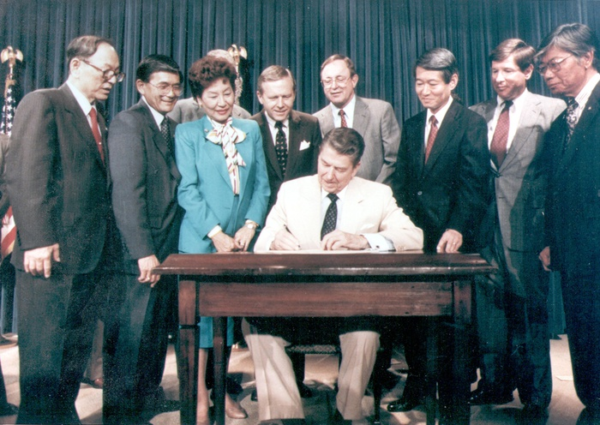
Civil Liberties Act of 1988
In 1988, President Reagan signed the Civil Liberties Act to compensate more than 100,000 people of Japanese descent who were incarcerated in internment camps.
The legislation offered a formal apology and paid out $20,000 to each surviving victim. The law won congressional approval only after a decade-long campaign by the Japanese-American community.
Notes:
For many years after the war, various individuals and groups sought compensation for the internees. The speed of the evacuation forced many homeowners and businessmen to sell out quickly; total property loss is estimated at $1.3 billion, and net income loss at $2.7 billion (calculated in 1983 dollars based on the Commission investigation below). The Japanese American Evacuation Claims Act of 1948, with amendments in 1951 and 1965, provided token payments for some property losses. More serious efforts to make amends took place in the early 1980s, when the congressionally established Commission on Wartime Relocation and Internment of Civilians held investigations and made recommendations.
In 1988, President Reagan signed the Civil Liberties Act to compensate more than 100,000 people of Japanese descent who were incarcerated in internment camps during World War II. The legislation offered a formal apology and paid out $20,000 in compensation to each surviving victim. The law won congressional approval only after a decade-long campaign by the Japanese-American community.
The federal act (Public Law 100-383) that granted redress of $20,000 and a formal presidential apology to every surviving U.S. citizen or legal resident immigrant of Japanese ancestry incarcerated during World War II. First introduced in Congress as the Civil Liberties Act of 1987 (H.R. 442) and signed into law on August 10, 1988, by President Ronald Reagan, the act cited "racial prejudice, wartime hysteria and a lack of political leadership" as causes for the incarceration as a result of formal recommendations by the Commission on Wartime Relocation and Internment of Civilians (CWRIC), a body appointed by Congress in 1980 to make findings on and suggest remedies for the incarceration.

Slide 9
Written Response
Using your notes, create an argument and support it with evidence from both perspectives. Your argument should be at least one complete paragraph and must refer to specific information from both sides.
Was the US Government justified in interning Japanese-Americans during WWII?

